Slide 1

Real-Time CNN-Based Emotion Detection
TEAM 1 CSE ICP
R. Swaroop, 22026A0514, Team Lead
P. Samuel, 22026A0510
v. Sri Harshita, 22026A0506

Slide 2
Contents
Problem Statement
Why we choose CNN
Why Not Traditional Classifiers
Dataset Overview
Preprocessing
CNN Model Architecture
Training the Model
Results
Further Optimizations
Conclusion

Slide 3
Problem Statement
In today’s world, recognizing human emotions in real-time can help improve mental health support, entertainment, and how we interact with machines. Many existing systems only detect emotions from still images and don’t respond meaningfully.
This project builds a real-time facial emotion recognition system using CNNs that works with live webcam input. It also suggests music, quotes, videos, and activities based on the user's emotion, making the system more interactive and helpful.

Slide 4
Why we choose CNN
Best suited for image data: CNNs are designed to automatically learn patterns in images (e.g., edges, shapes, facial features), which is essential for facial emotion recognition
Supports real-time processing: Once trained, CNNs are fast and efficient for live predictions using webcam feeds.
No manual feature extraction needed: Unlike SVMs, decision trees, or regressors, CNNs learn important features from raw image pixels directly, reducing preprocessing effort.
CNN uses Conv2D + ReLU + MaxPooling to automatically learn features from raw pixels

Slide 5
Why Not Traditional Classifiers (SVM, Logistic Regression, etc.):
Classifiers (SVM, Random Forest): Need manual feature extraction; less accurate on image pixels.
Regressors: Predict continuous values, but emotion detection is a classification task (7 discrete classes).
CNNs automatically learn features + higher accuracy in image tasks.

Slide 6
Dataset Overview
Dataset Name: FER2013 (Facial Expression Recognition 2013)
Size: 35,887 entries
three columns: "emotion“, "pixels," and "Usage."
Emotion: 0=Angry, 1=Disgust, 2=Fear, 3=Happy, 4=Sad, 5=Surprise, 6=Neutral
pixels: A string of space-separated integers (0–255) representing grayscale pixel values of 48x48 pixel images.
Each row corresponds to a 48x48 grayscale image (2,304 pixels per image).
Pixel values range from 0 (black) to 255 (white).
Usage: Indicates data split ( "Training," "PublicTest," "PrivateTest").
Training 80% , validation 10% , Testing 10%

Slide 7
Preprocessing
Detects missing values using data.isnull().values.any() and drops them with data.dropna().
Converts pixels column to arrays using np.fromstring(pixel, sep=' ') and reshapes to (48, 48, 1).
Normalizes images with division by 255.
Encodes labels using to_categorical(data['emotion'].values, num_classes=7).
Note: Applied to training, validation, and test sets to produce X_train, y_train, X_val, y_val, X_test, y_test.

Slide 8
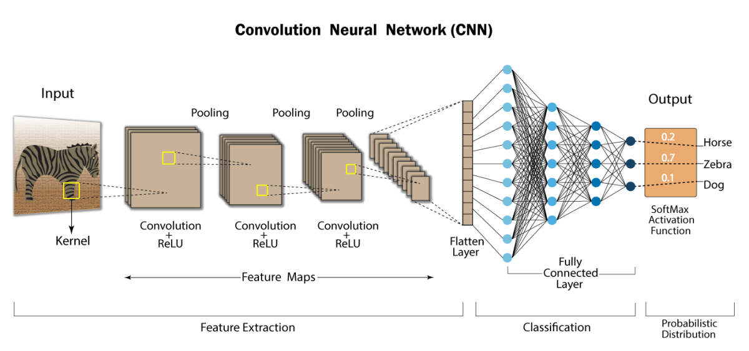
CNN Model Architecture

Slide 9
Input Layer:
image
Height and width of each filter
Image height in pixels
Conv2D(64, (3, 3), activation='relu', input_shape=(48, 48, 1))
1 channel
Gray scale image
Represents number of filters
Activation function
Image width in pixels
Detects edges, curves and other patterns of image

Slide 10
Hidden Layers:
128 filters
learn more abstract petterns
To introduce non linearlity
Conv2D(128, (3, 3), activation='relu')
BatchNormalization()
normalizes the output , mean 0 , unit variance
Reduces the image dimenesion
MaxPooling2D(pool_size=(2, 2))

Slide 11
Hidden Layers:
3d features: height, width, channels
Converts the multidimensional tensor into 1d vector
Flatten()
Dense(512, activation='relu')
No of neurons
Each neuron receives input and learns high level patterns
Dropout(0.5)
Drops 50% of neurons
Prevent overfitting

Slide 12
Output Layer:
7 neurons i.e
7 emotion categories
Dense(7, activation='softmax')
Converts outputs to probabilities that sum to 1
The neuron with the highest probability is the predicted class.

Slide 13
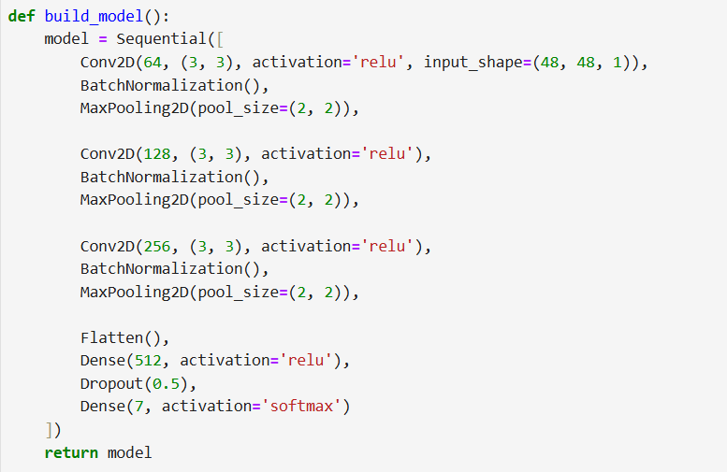

Slide 14
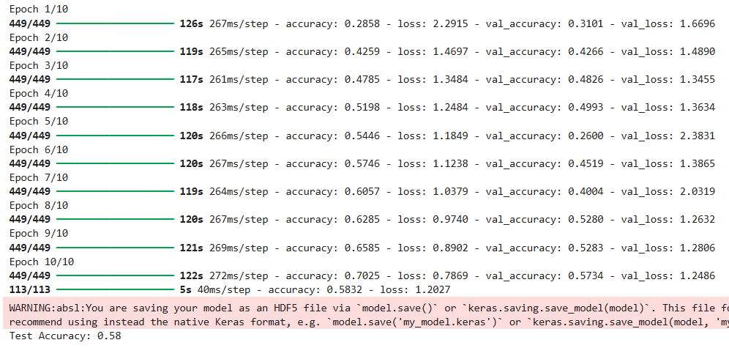
Training the Model

Slide 15
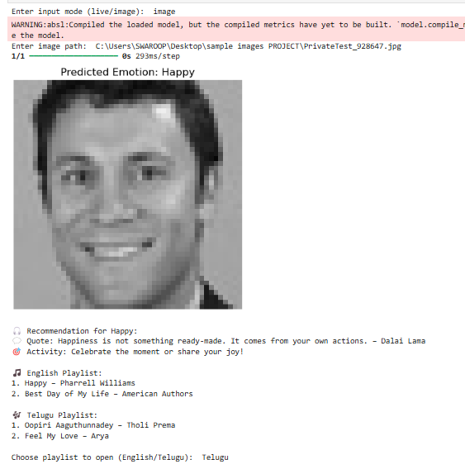
Results
accuracy: 58%
Provides an end-to-end emotion-aware recommendation system
Helps users feel emotionally supported through motivational content and music
Offers multilingual (English/Telugu) playlist options for personalized user experience
Can work with static images
or real-time webcam input

Slide 16
Further Optimizations
Trying to reduce the testing time of model without changing the epochs.
Trying to add or create a huge dictionary based recommendations , not to limited for 2-3 items.
Trying to improve the accuracy by adding more layers but computationally complexive task.
If all the above are possible then try to create frontend.

Slide 17
Conclusion
The emotion recognition project successfully developed a robust system to detect and classify human emotions from facial images and live video feeds, leveraging a Convolutional Neural Network (CNN) trained on the FER2013 dataset.
The primary objective was to accurately identify seven emotions—Angry, Disgust, Fear, Happy, Sad, Surprise, and Neutral—and provide personalized recommendations to enhance user experience. This was achieved through a well-structured pipeline encompassing data preprocessing, model training, real-time prediction, and emotion-based recommendations.
The project demonstrates the power of deep learning in interpreting human emotions, with potential applications in mental health support, human-computer interaction, and personalized content delivery.

Slide 18
THANK YOU

